Slide 1
Human Computer Interaction
Human Computer Interaction

Slide 2
Outline
What is HCI
History
What is Human, Computer and Interaction
Goals
User Interaction Design
Interaction Styles
Interaction Devices
Future
Conclusion
Human Computer Interaction

Slide 3
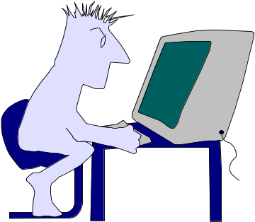
What is Human Computer Interaction
“Human-computer interaction is a discipline concerned with the design, evaluation and implementation of interactive computing systems for human use and with the study of major phenomena surrounding them”
Human Computer Interaction
Notes:
Talk about different requirements for real-time vs. Non-real-time
Time, quality

Slide 4
History
1945 – MEMEX by Vanevar Bush
1963 – SketchPad and Light Pen by Ivan Sutherland
1964 – Mouse by Douglas Engelbart
1973 – Alto by Xerox PARK
1983 – Apple Lisa
1987 – Windows
Human Computer Interaction

Slide 5
Human
Humans are limited in their capacity to process information. This has important implications for Design
Information is received and responses given via a number of input and output channels:
  Visual Channel
  Auditory Channel
  Haptic Channel
  Movement
Information is stored in memory:
  Sensory Memory
  Working Memory
  Long-Term Memory
Human Computer Interaction

Slide 6
Computer
There is not much difference in Human and Computer
Computer consist of
  Input Devices
  Output Devices
  Memory
  Processing
Computer can be Mobile, Spacecraft Cockpit, Microwave Oven or VCRs etc.
Human Computer Interaction

Slide 7
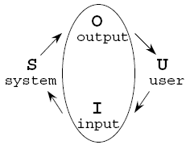
Interaction
HCI is concerned with joint performance of Task by Human & Computer
Communication between The User and The System
Physical Interaction
      Interaction Devices
Conceptual Interaction
      Interaction Styles
Human Computer Interaction

Slide 8
Goals
The main goal of HCI is Usability
“It is a measure of the effectiveness, efficiency and satisfaction with which specified user can achieve specified goals in a particular environment”
A usable System is:
  Easy to Learn
  Easy to Remember how to Use
  Effective to Use
  Efficient to Use
  Safe to Use
  Enjoyable To Use
Human Computer Interaction

Slide 9
Cognition
Cognition is the processing of information
It includes:
  Perception
  Attention
  Pattern Matching
  Memory
  Language Processing
  Decision Making
  Problem Solving
Human Computer Interaction

Slide 10
User Interaction Design
  Data Collection
  Data Analysis
  User Modeling
  Design
  Prototyping
  Evaluation
Human Computer Interaction

Slide 11
Identify needs/establish requirements
(Re)Design
Evaluate
Build an interactive version
Final product
Human Computer Interaction

Slide 12
Interaction Styles
  Command Line Interface
  Menus
  Question & Answer Dialogue
  Form-Fill Interface
  WIMP
  Direct Manipulation
  Natural Language
Human Computer Interaction

Slide 13
Interaction Devices
Input Devices
  Keyboards
  Mouse, Trackballs, Touch Pads
  Touch Screens
  Speech Input
  3D trackers, 3D Mouse
Output Devices
  Screens
  Printers
  Sound Output
Human Computer Interaction

Slide 14
Future
  Artificial Intelligent
  Virtual Reality
  New Interface Devices
Human Computer Interaction

